Slide 1
Chapter 2 Objectives
The CCNA Topics Covered in this chapter include:
  What is static route?
  Configuration and verification of static routes
  What is default route?
  Configuration and verification of default routes

Slide 2
IP Routing
The different types of routing are:
  Static routing
  Default routing
  Dynamic routing

Slide 3
Static Routes
Benefits
  No overhead on the router CPU
  No bandwidth usage between routers
  Adds security
Disadvantage
  Administrator must really understand the internetwork
  If a network is added to the internetwork, the administrator has to add a route to it on all routers
  Not feasible in large networks

Slide 4
Static Route Configuration
R1(config)#ip route [destination-network] [mask]
{ next-hop-address | exit-interface}[distance]
  ip route The command used to create the static route.
  destination-network The network you’re placing in the routing table.
  mask The subnet mask being used on the network.
  next-hop-address The address of the next-hop router that will receive the packet and forward it to the remote network. This is a router interface that’s on a directly connected network.
  exit-interface You can use it in place of the next-hop address if you want, but it’s got to be on a point-to-point link, such as a WAN
  administrative_distance By default, static routes have an administrative distance of 1 (or even 0 if you use an exit interface instead of a next-hop address)

Slide 5
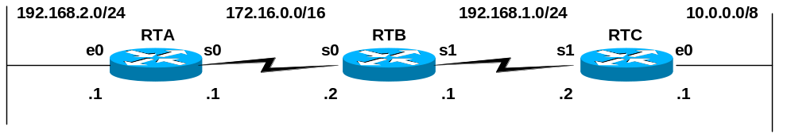
Directly Connected Networks and the IP Routing Table
RTA#show ip route
Codes: C - connected,.. <Other codes and gateway information omitted>
C 172.16.0.0/16 is directly connected, Serial0
C 192.168.2.0/24 is directly connected, Ethernet0
RTB#show ip route
Codes: C - connected,.. <Other codes and gateway information omitted>
C 172.16.0.0/16 is directly connected, Serial0
C 192.168.1.0/24 is directly connected, Serial1
RTC#show ip route
Codes: C - connected,.. <Other codes and gateway information omitted>
C 10.0.0.0/8 is directly connected, Ethernet0
C 192.168.1.0/24 is directly connected, Serial1
The Routing Tables
Notice that the routers only know about their own directly connected networks.
They are not sharing routing information because we have not configured any static routes or dynamic routing protocols.

Slide 6
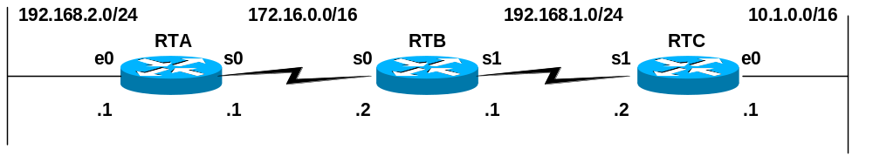
Directly Connected Networks and the IP Routing Table
RTA#show ip route
C 172.16.0.0/16 is directly connected, Serial0
C 192.168.2.0/24 is directly connected, Ethernet0
RTA#ping 172.16.0.1
Sending 5, 100-byte ICMP Echos to 172.16.0.1, timeout is 2 seconds:
!!!!!
Success rate is 100 percent (5/5), round-trip min/avg/max = 56/57/60 ms
RTA#ping 172.16.0.2
!!!!!
RTA#ping 192.168.1.1
.....
RTA#ping 192.168.1.2
.....
RTA#ping 10.1.0.1
.....
Routing – Only directly connected hosts (routers)
Routers can only reach networks known about in its own routing table.

Slide 7
Configuring Static Routes
RTA(config)#ip route 192.168.1.0 255.255.255.0 172.16.0.2
RTA#show ip route
Codes: C - connected, S - static,
C 172.16.0.0/16 is directly connected, Serial0
S 192.168.1.0/24 [1/0] via 172.16.0.2
C 192.168.2.0/24 is directly connected, Ethernet0
Network/subnet route
Intermediate-Address (usually “next-hop”)
Basic static route example
Be sure to use the proper subnet mask!

Slide 8


LAB – Static Route Configuration
R1
R2
30.0.0.2
R3
20.0.0.1
30.0.0.1
20.0.0.2
S0
10.0.0.1
S0
S0
S1
E0
E0
40.0.0.1
R2# config t
R2(config)#ip route 10.0.0.0 255.0.0.0 20.0.0.1
R2(config)#ip route 40.0.0.0 255.0.0.0 30.0.0.2
10.0.0.2
A
B
40.0.0.2
R1# config t
R1(config)#ip route 30.0.0.0 255.0.0.0 20.0.0.2
R1(config)#ip route 40.0.0.0 255.0.0.0 20.0.0.2
R3# config t
R3(config)#ip route 10.0.0.0 255.0.0.0 30.0.0.1
R3(config)#ip route 20.0.0.0 255.0.0.0 30.0.0.1

Slide 9
Verifying Static Route Configuration
After static routes are configured it is important to verify that they are present in the routing table and that routing is working as expected.
The command show running-config is used to view the active configuration in RAM to verify that the static route was entered correctly.
The show ip route command is used to make sure that the static route is present in the routing table.

Slide 10
Removing IP Static Route
R1
R2
30.0.0.2
R3
20.0.0.1
30.0.0.1
20.0.0.2
S0
10.0.0.1
S0
S0
S1
E0
E0
40.0.0.1
R2# config t
R2(config)#no ip route 10.0.0.0 255.0.0.0 20.0.0.1
R2(config)#no ip route 40.0.0.0 255.0.0.0 30.0.0.2
10.0.0.2
A
B
40.0.0.2
R1# config t
R1(config)#no ip route 30.0.0.0 255.0.0.0 20.0.0.2
R1(config)#no ip route 40.0.0.0 255.0.0.0 20.0.0.2
R3# config t
R3(config)#no ip route 10.0.0.0 255.0.0.0 30.0.0.1
R3(config)#no ip route 20.0.0.0 255.0.0.0 30.0.0.1

Slide 11


Default Routes
Can only use default routing on stub networks
Stub networks are those with only one exit path out of the network
Stub Network
172.16.1.0
Network
SO
10.0.0.0
A
B
172.16.2.2
B
172.16.2.1
ip route 0.0.0.0 0.0.0.0 172.16.2.2
  This route allows the stub network to reach all known networks beyond router A.

Slide 12
Configuring Default Routes
Default routes are used to route packets with destinations that do not match any of the other routes in the routing table.
A default route is actually a special static route that uses this format:
ip route 0.0.0.0 0.0.0.0 [next-hop-address | outgoing interface]
This is sometimes referred to as a “Quad-Zero” route.
Example using next hop address:
Router(config)#ip route 0.0.0.0 0.0.0.0 172.16.4.1
Example using the exit interface:
Router(config)#ip route 0.0.0.0 0.0.0.0 s0/0

Slide 13
Default Route LAB Configuration
R1
R2
R3
20.0.0.1
30.0.0.1
30.0.0.2
S0
S1
10.0.0.1
E0
S0
40.0.0.1
S0
E0
20.0.0.2
A
B
40.0.0.2
10.0.0.2
R2# config t
R2(config)#ip route 10.0.0.0 255.0.0.0 20.0.0.1
R2(config)#ip route 40.0.0.0 255.0.0.0 30.0.0.2
R1# config t
R1(config)#ip route 0.0.0.0 0.0.0.0 20.0.0.2
R3# config t
R3(config)#ip route 0.0.0.0 0.0.0.0 30.0.0.1

